Slide 1
Predicting attrition of employee
Using machine learning

Slide 2
Objective
In recent years, many companies especially IT companies faces high attrition rate of their employee. This leads to drop out of projects, delaying project deliverables and some financial losses
To overcame this, our project aimed to develop the chance of employee to left the current company by machine learning algorithms
By providing necessary details of employee , model can predict his/her status

Slide 3
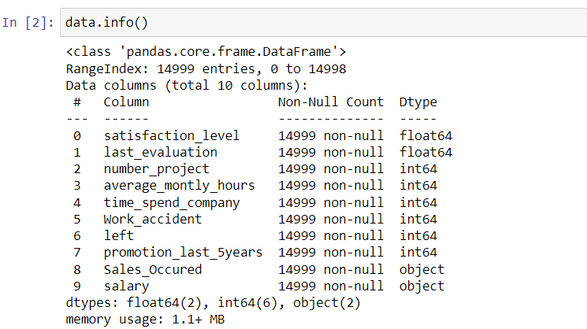
Dataset
Mentor provided dataset is used to develop the machine learning model
Above are the information about given dataset

Slide 4
Data Cleaning/Preprocessing
Checked for null values , no null values is detected
Detected duplicated records and dropped it
Checked outliers by data visualization
Not much outliers was detected and detected outliers are removed

Slide 5
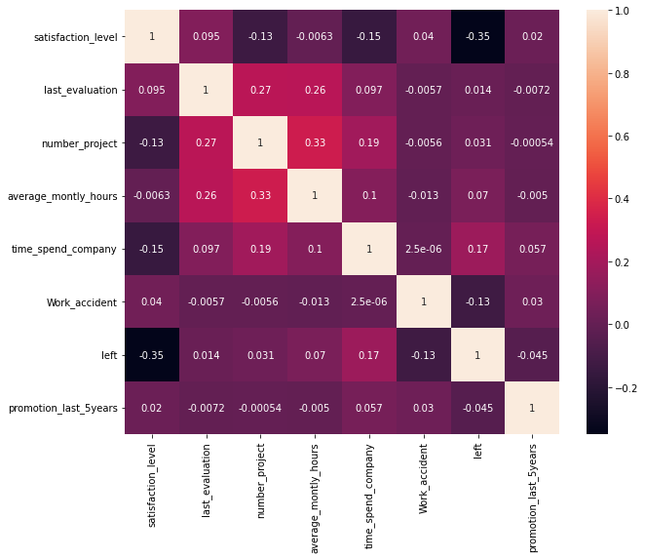
Co-relation matrix

Slide 6
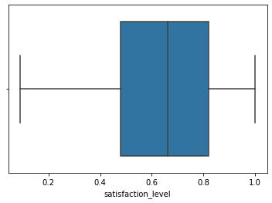
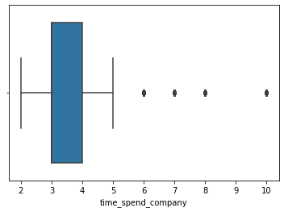
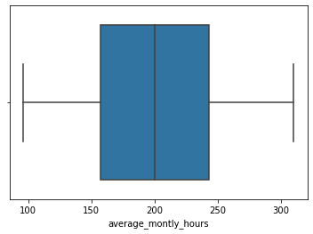
Data visualization

Slide 7
Model building
Split into dependent and independent features
Then dataset is split into train and test datasets
Linear Regression , Lasso, Ridge, KNN, Random Forest, Decision Tree, SVM models are used for prediction

Slide 8
accuracy
At last accuracy given by models are
Random Forest :98.38766211005958 %
Logistic Regression:83.14055380301437 %
SVM :83.38590956887487 %
Decision Tree :96.38976515948124 %
KNneighbors :94.28671573781984 %
Conclusion
Random Forest gives high accuracy than other models

Slide 9
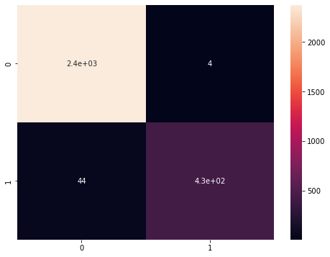
Confusion matrix of random forest

